Slide 1



SILIGURI INSTITUTE OF TECHNOLOGY DEPARTMENT OF ELECTRICAL ENGINEERING
Presentation on: Microsoft Stock Price Prediction Using ML.
By_
Bidyasagar Mallick – 11901621032
Biswajit Roy – 11901621031
Prosun Majumder – 11901621029
Tapas Sarkar – 11901621038

Slide 2
INTRODUCTION:
Windows 10 is one of the operating systems that so many people love about Microsoft. When Microsoft released Windows 10, it was announced that it would be the last version of windows and then Microsoft will only work on its updates. But now Microsoft has once again garnered a lot of attention from the world as the release of Windows 11 is just around the corner. So now will be a good time to predict Microsoft’s stock price as it is getting a lot of attention.
In the section below, I will take you through the task of Microsoft stock price prediction with Machine Learning by using the Python programming language.

Slide 3
Problem Statement:
We’ll dive into the implementation part of this article soon, but first it’s important to establish what we’re aiming to solve. Broadly, stock market analysis is divided into two parts – Fundamental Analysis and Technical Analysis.Fundamental Analysis involves analyzing the company’s future profitability on the basis of its current business environment and financial performance.Technical Analysis, on the other hand, includes reading the charts and using statistical figures to identify the trends in the stock market.As you might have guessed, our focus will be on the technical analysis part. We’ll be using the dataset of Microsoft stock prices from April 2015 to April 2021 to build a model capable of estimating the stock prices. Time to dive in!

Slide 4

Why you should invest in Microsoft stock?

Slide 5
Microsoft shares have dipped over 20% year over year, making now an excellent time to invest. The company is one of the biggest names in cloud computing, with plans to expand its market share. Potential plans to grow its stake in a company of the future could provide significant gains over the long term.

Slide 6
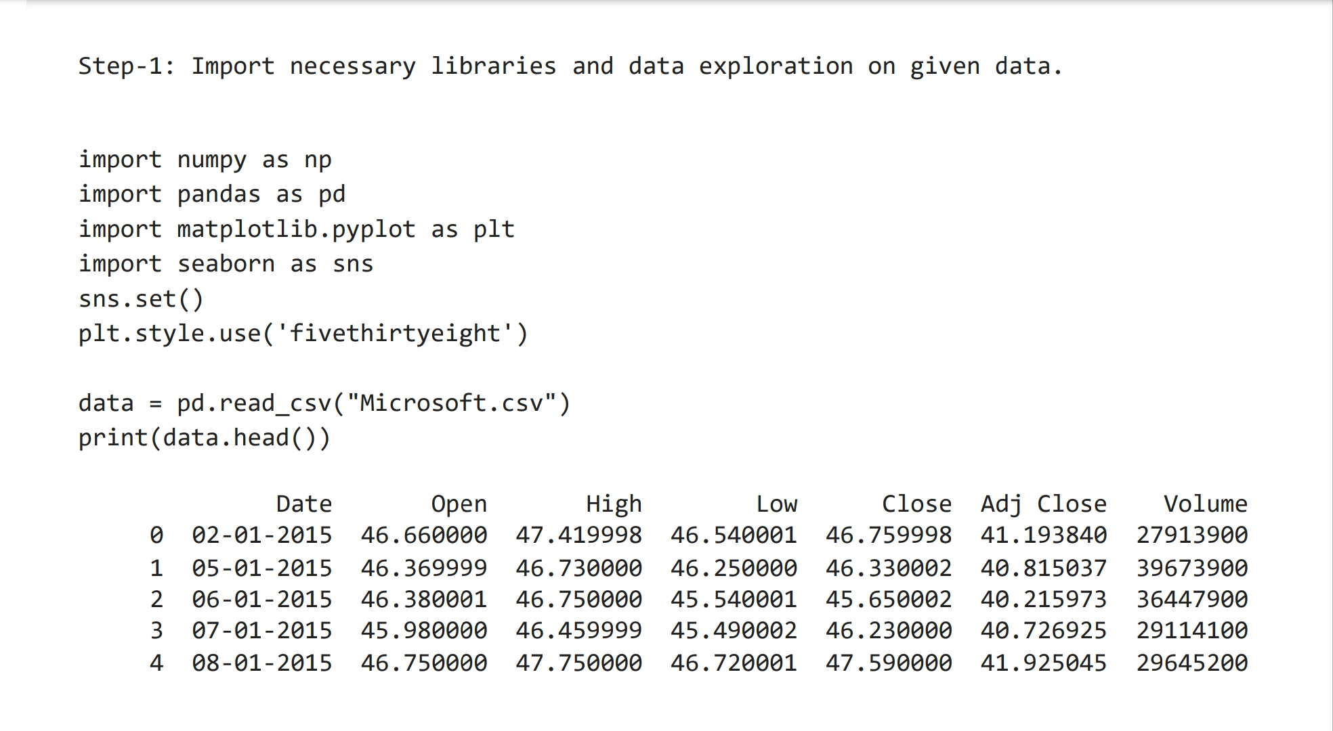

Slide 7
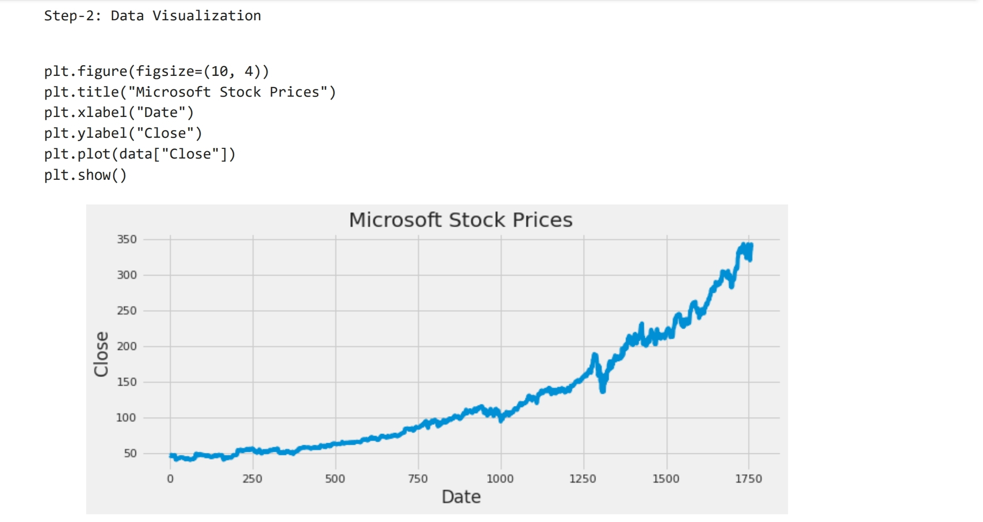

Slide 8
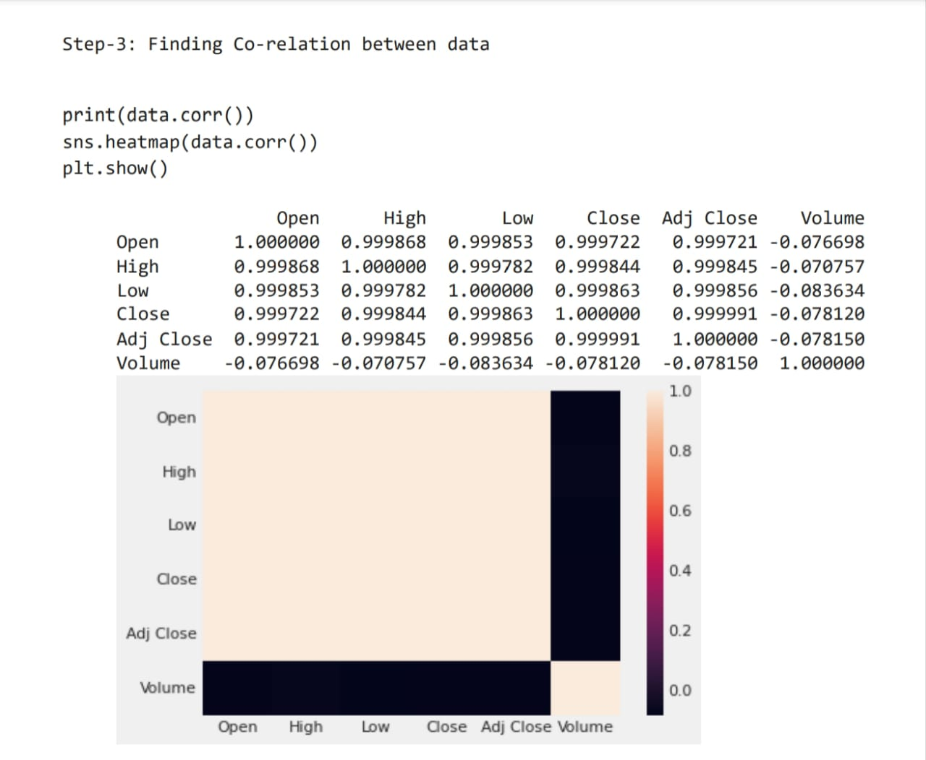

Slide 9
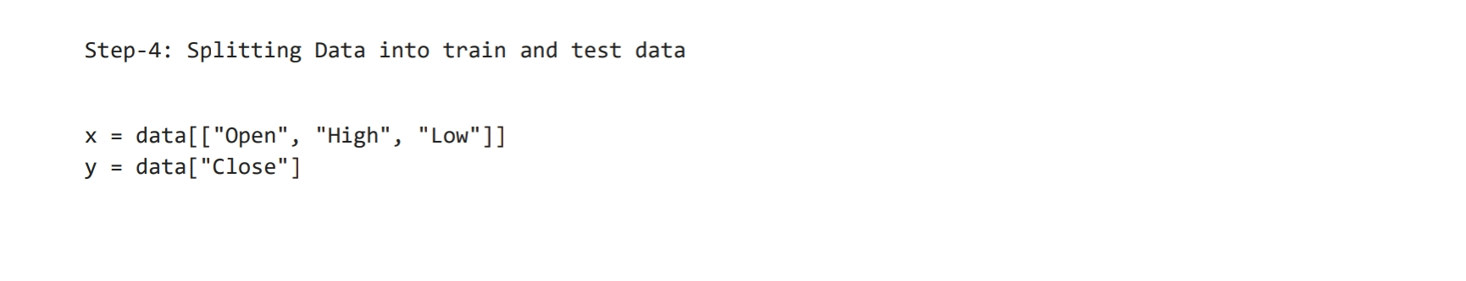
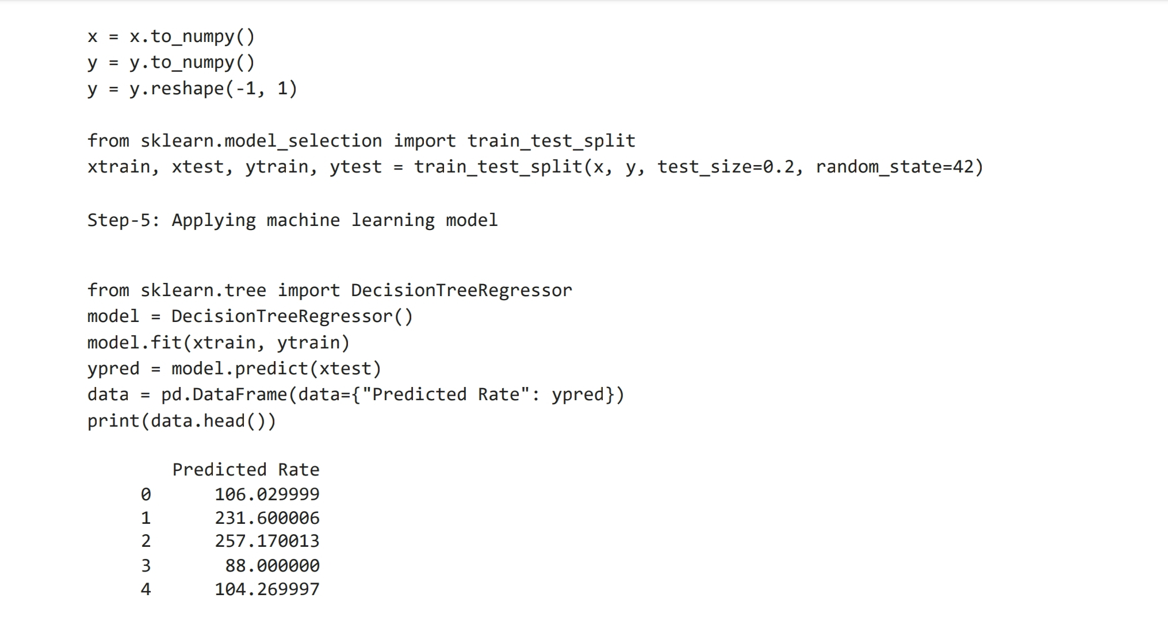

Slide 10
CONCLUSION:
Time series forecasting is a very intriguing field to work with, as I have realized during my time writing these articles. There is a perception in the community that it’s a complex field, and while there is a grain of truth in there, it’s not so difficult once you get the hang of the basic techniques.I am interested in finding out how LSTM works on a different kind of time series problem and encourage you to try it out on your own as well. If you have any questions, feel free to connect with me in the comments section below.

Slide 11


THANK YOU!

